Slide 1
Assignment 2
Team 2

Slide 2
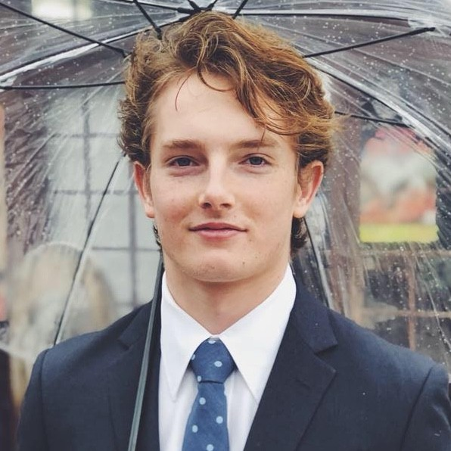
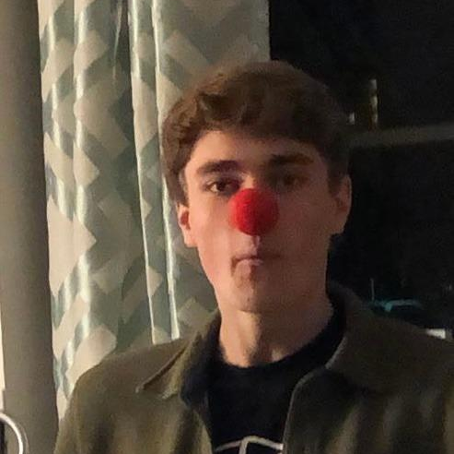
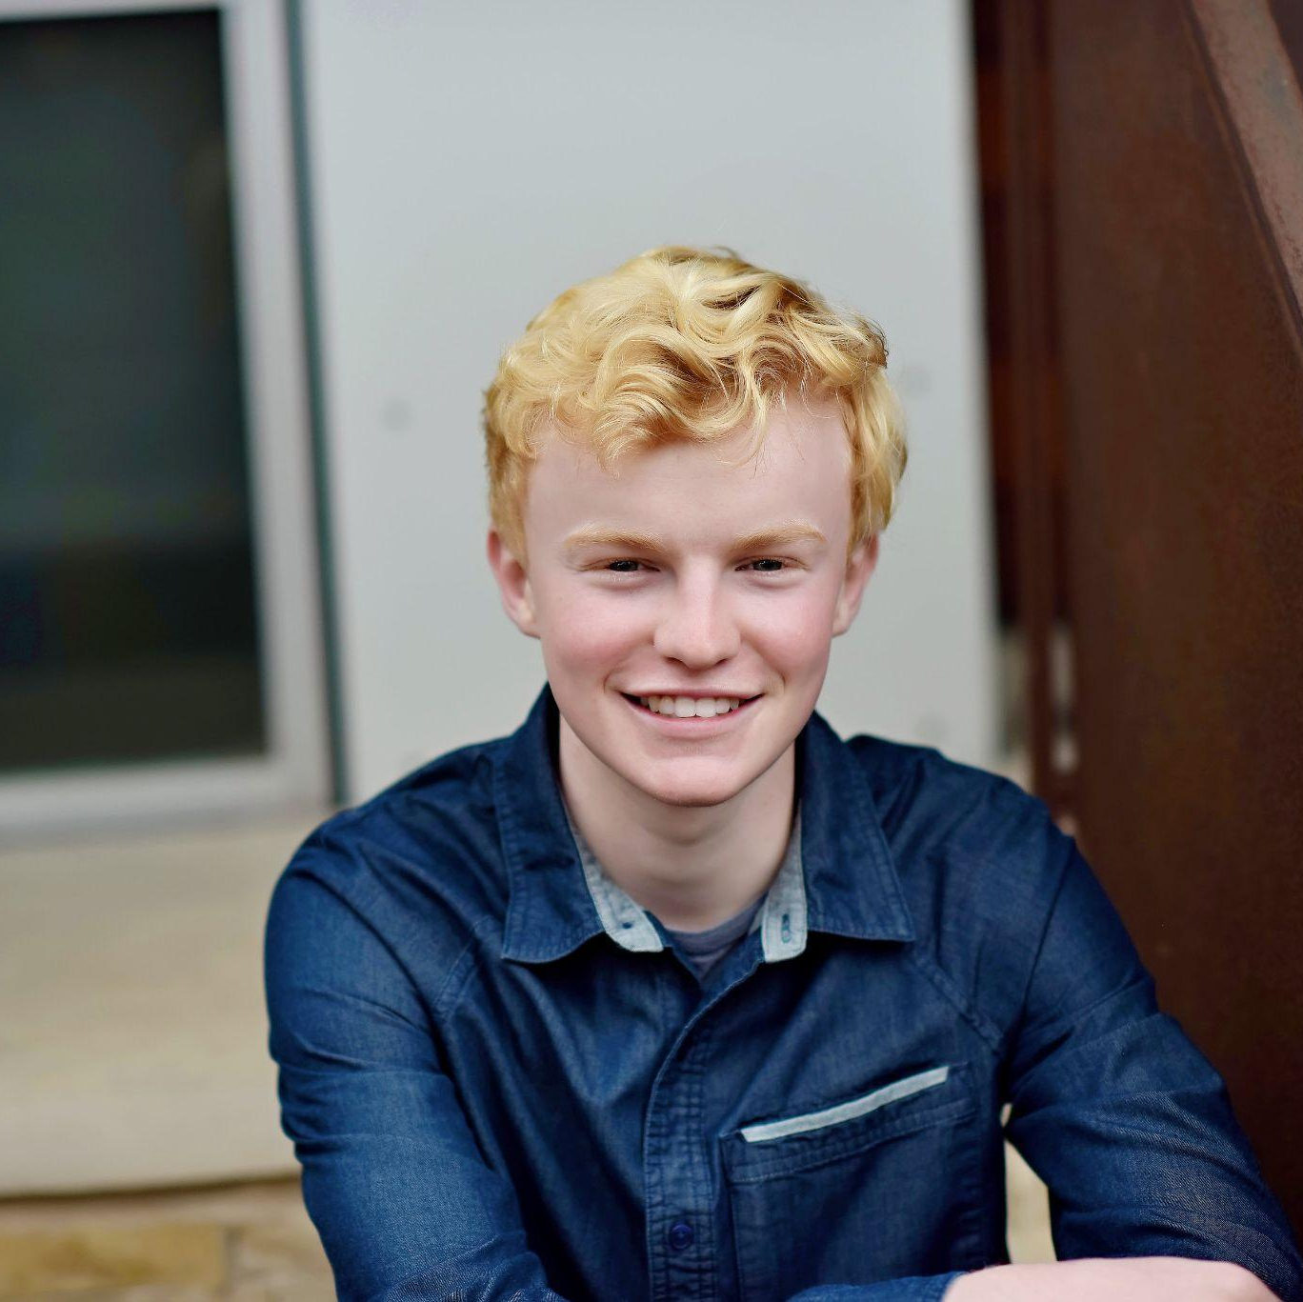
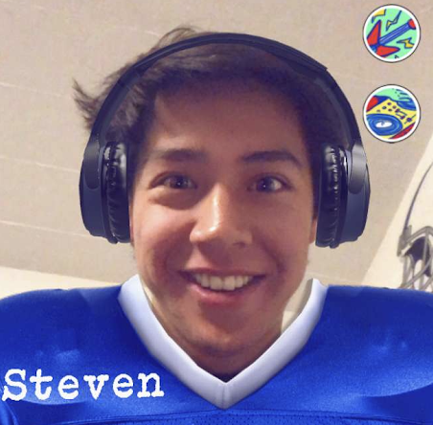
Our Team and Domain
Sebastian J.
Connor H.
Corbin S.
Steven K.
Studio Theme: Becoming Iron Man
Domain: Interacting with Music

Slide 3
Recap POV

Slide 4

we met…
Gus, a music creator and listener.
we were surprised to notice…
he expressed frustration with the platforms he uses to listen and learn music.
we wonder…
if this means there is gaps to fill in music learning technology
it would be game-changing to…
put learning in the hands of the musician with adaptive technology

Slide 5
Needfinding Round 2

Slide 6
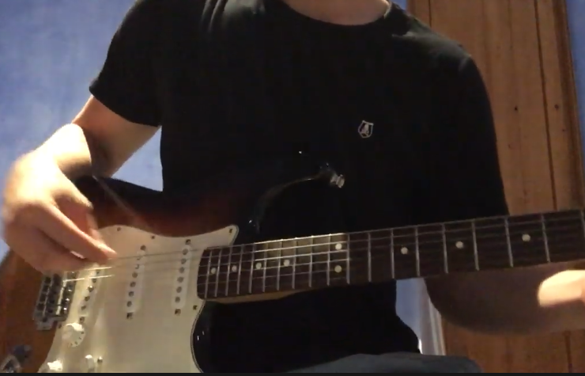

Thana
“I just want to be able to work with musicians who I get along with. There’s plenty of talented musicians but it’s not always easy to collaborate. People are the most important part, and the music comes after that.”
Streaming platforms could use more social interaction
Teachers and learners need to have the same level of commitment
Finding peers of similar talent vs. peers you enjoy being around
Thana
Guitarist, Former Music Gear Reseller,
Student at Pittsburgh

Slide 7

Davis
“The Spotify Discover Weekly gives me songs of the genres that I already listen to, so I don’t end up exploring new genres very often.”
Told by friends that he has “bad” music taste, has had bonding experiences meeting new people who shared music taste
Davis
Clinical Operations Associate, infrequent music listener, lives in Charleston, SC

Slide 8
POV Statements

Slide 9
POV 1 – revised
we met…
Gus, a music creator and listener.
we were surprised to notice…
he expressed frustration over his learning experience
we wonder…
if this means music learning is overgeneralized
it would be game-changing to…
put learning in the control of the musician
Notes:
How might we reduce frustration during the learning process?
How might we get musicians access to help from real people?
How might we make learning programs specific to the user?
How might we customize learning speed using data?
How might we recap how learning is going with real results?
How might we create a new type of learning platform?
How might we keep musicians excited to learn?
How might we decide someone’s skill level accurately?
How might we connect learners to teachers?
How might we let people learn instruments together?
How might we make learning accessible and affordable?

Slide 10
POV 2
we met…
Thana, a guitarist in Pittsburgh
we were surprised to notice…
finding people who he enjoyed music with in a new city was hard
we wonder…
what makes it hard to enjoy old hobbies in a new place
it would be game-changing to…
help people connect with a new city through music
Notes:
How might we connect musicians based on skill level and personality?
How might we help musicians weed out bad matches?
How might we let musicians explore opportunities in the area?
How might we introduce musicians virtually?
How might we make collaborating more enjoyable?
How might we help people figure out what they want musically?
How might we get people excited about meeting fellow musicians?
How might we match musicians with similar goals?
How might we help someone explore a new city through music?
How might we combine music and friendship in a productive way?

Slide 11
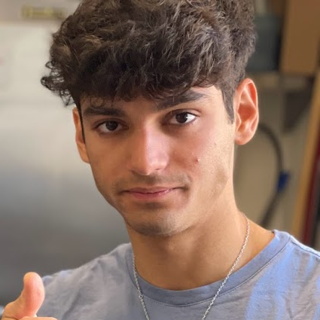
POV 3
we met…
Sauren, a drummer and a metalhead
we were surprised to notice…
his music taste is niche and he is skeptical about sharing it with friends
we wonder…
if this frustrates him or makes him uncomfortable
it would be game-changing to…
help listeners easily find others with similar niche music taste
Notes:
How might we empower listeners to have separate music profiles for different moods?
How might we keep music private to listeners when they want?
How might we diversify music libraries automatically based on the environment?
How might we enable listeners to live edit music they enjoy to keep old music fresh?
How might we connect listeners from similar communities to find niche music?
How might we relate music listening to a social setting?
How might we keep extreme listeners from losing interest over time?
How might we allow listeners of niche music to ease their friends into new genres?
How might we help people who find making playlists difficult?
How might we combine music and friendship in a productive way?

Slide 12
HMW Statements

Slide 13
HMW 1
How might we make learning programs specific to the user?
POV 1
We met Gus, a music creator and listener. We were surprised to notice he didn’t have control over his learning experience and expressed frustration over learning platforms. We wonder if this means music learning is overgeneralized. It would be game-changing to put learning in the control of the musician.

Slide 14
HMW 2
How might we help someone explore a new city through music?
POV 2
We met Thana, a guitarist, student, and former music gear reseller. We were surprised to notice that finding people he enjoyed music with in a new city was hard. We wonder what makes it hard to enjoy old hobbies in a new place. It would be game-changing to help people connect to a new city through music.

Slide 15
HMW 3
How might we connect listeners from similar communities to find niche music?
POV 3
We met Sauren, a metalhead, drummer, and avid music listener. We were surprised to notice his music taste varies from when he is alone to when he is in different situations around others. We wonder if this frustrates him or makes him uncomfortable. It would be game-changing to help listeners cater their listening to their environment

Slide 16
Solutions

Slide 17
Solution 1
Giving learners the option of both real teachers and self-led learning, along with rewards for completing learning goals

Slide 18
Solution 2
Connect city sightseeing with locally themed playlists to create an interactive experience based on history and environment

Slide 19
Solution 3
Help listeners find and meet people with similar music tastes based on exchanging and sharing playlists and songs

Slide 20
Prototypes

Slide 21
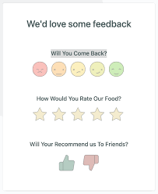
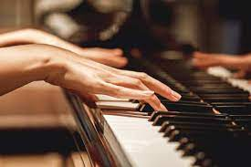
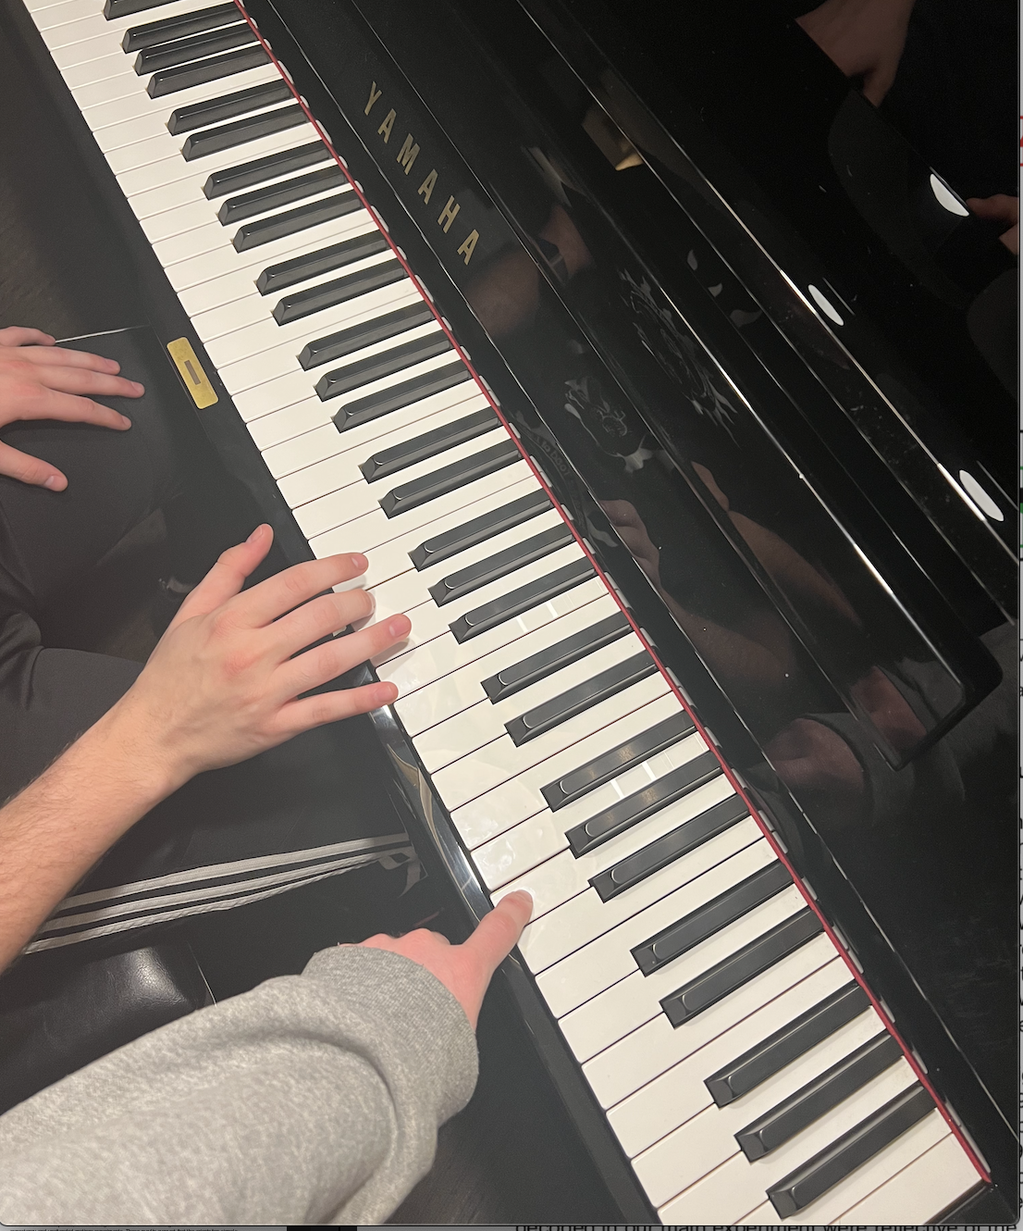
Prototype 1
Assumption: People want an array of learning options, as well as feedback, when learning a new task
We gave a person the task of learning a very simple piece on piano, ‘hot cross buns’
We gave them options to access learning hints and/or live instruction
We assessed their performance and asked about their satisfaction

Slide 22
Results
Things that worked
Having multiple options helped our participant when he got stuck
Hints were useful in early stage progress
Things that didn’t work
The concept of how to use hints was confusing to our participant
The participant was unsure of how to start until a demo was performed
Surprises
The subject learned quickly despite having no musical experience
Hints weren’t easy to communicate without hands on teaching
New learnings
Self learning requires thoroughly explained information to avoid conclusion
The learner was satisfied only once he could play the piece accurately on his own

Slide 23
Validity:
This assumption is a viable one in that people want a number of ways to learn, interactive feedback, and satisfaction of completing learning goals

Slide 24
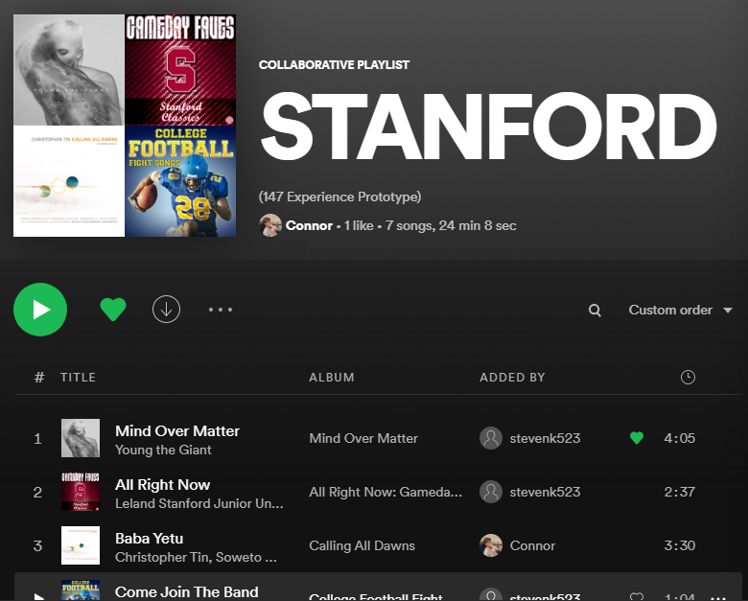

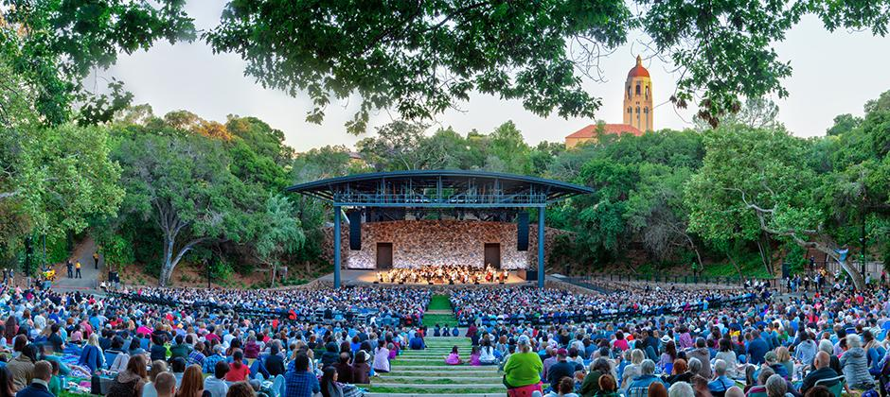
Prototype 2
We wanted to see if the process of discovering city-related playlists as you explore a new city enhances your travel experience.
We asked the user to listen to specific songs in locations relevant to the song with a blurb
We asked the user if (and how) listening to the playlist enhanced their trip to campus
We gave a potential user a playlist related to facets of Stanford

Slide 25
Results
Things that worked
The user liked having a story behind the music they were listening to
The user found that they listened to the music more intently
Things that didn’t work
The user did not like some of the songs (outside of their genre of choice)
The user wanted to override the requirement to be at the location to hear the song
Surprises
The user was interested enough to travel to certain landmarks to hear songs
New learnings
The user showed interest in adding his own song to a landmark with a blurb

Slide 26
Validity:
This assumption is a viable one in that people enjoyed listening to music connected to their surroundings and listened to the music more intently.

Slide 27

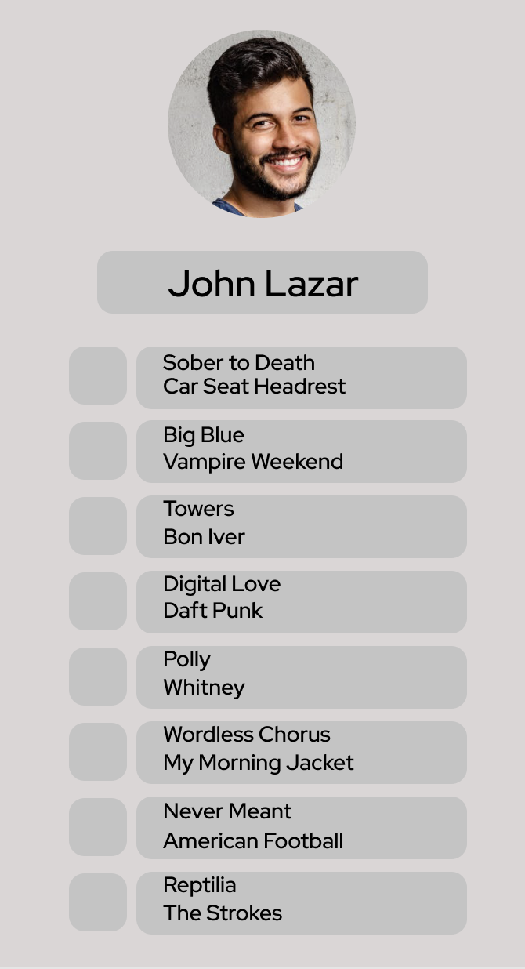




Prototype 3
We wanted to see if people were interested in meeting people in real life with similar music tastes
We let our participants fill out a profile.
They viewed a tester profile with 10 songs belonging to a hypothetical user.
We instructed the participant to suggest a song to the fictitious user based on their profile. They received a song from the other profile in return.
We then asked the participant if the wanted to “accept” the incoming song request. If they accept – we informed the participant that the fictitious user also accepted their song suggestion and that they would now be connected

Slide 28
Results
Things that worked
The users liked how their playlist acted as their profile
The users were motivated to suggest a song to connect to the fictitious profile
Things that didn’t work
One user thought the idea was restrictive and would have liked to see more information about the person before getting involved
The users thought it took too long to suggest a worthwhile song
Surprises
One user wished this was a real app they could use immediately
New learnings
Different people value music taste in others at different levels
Users liked to use their liked songs and playlists as their profile

Slide 29
Validity:
This assumption is a viable one in that people want to meet others with both similar and different music tastes. Individuals value meeting others AND discovering new music in a social media paradigm.

Slide 30
Conclusions

Slide 31
Summary
We were most satisfied with Prototypes 1 and 3
We were most invested in HMW 1 and 3
Music learning and music matchmaking
Need to improve framework of teaching for 1st prototype
How do we generalize Prototype 2 to other locations?
Prototype 3 could be valid for matching listeners in an exciting and easy way
Do these ideas already exist? How do we create something unique and usable?

Slide 32
Thank You!

Slide 33
How might we make music learning programs specific to the user?
Self reporting and comparison to existing users
Access to teachers who can give feedback asap
Connection with users of similar skill level
Satisfaction reports after learning tasks
Computer responds to playing via sound input
Guitar hero type platform for learning
Local popups to meet/play with other users
Centralize access to different mediums of learning
Rewards for completing learning goals
Auto adjusted pace that can be changed manually
Combining real teachers with self teaching technology
Questions to assess user’s proficiency to tailor difficulty
Duolingo but for music learning
Leverage Spotify listening data to create learning program tailored to user’s music taste

Slide 34
2. How might we help someone explore a new city through music?
City Playlists connected to sightseeing
Music unlocked like Pokemon Go
Unlock music by taking pictures of places
Unlock playlists from geolocation
Free live music scavenger hunt
Music social groups
New musician events at local hotspots
Social media app where you meet people through music recommendation
Get information about local concerts
Curate musical tours (museums / concerts)
Show music that people in that area are interested in
Connect music tourists to music tour guides
Have users rate live music experiences to recommend to other users
AR Music Tour

Slide 35
3. How might we connect listeners of niche music?
Leverage an existing platform like Reddit
Do some analytics involving Spotify
Twitter?
Online forums
See who is listening to same song at same time
Tinder for music taste
Subscription service to indie concerts in your area
Concert Buddies!
Live music and in person meetings
Jam sessions
Marriage pact for music taste
Connect similar listeners by proximity
Leverage listening data from Spotify to pair users/create communities

